Slide 1


Day 30
contact@anubhavtrainings.com
ABAP RESTFUL APPLICATION PROGRAMMING

Slide 2

Agenda – Day 30
Understanding Base Behaviour Definition
Implementation of Base Behaviour Definition
Create Projection CDS View for Processor
Create/Implement Behaviour Definition for Processor
Create Service Definition to Expose Entity
Implement Service Binding
Create CDS View for Approver
Implementation of Behaviour Definition
Create Service Definition to Expose Entity
Create Service Binding

Slide 3
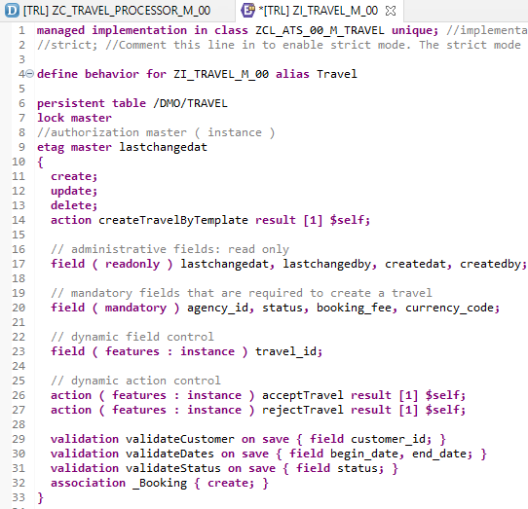
Implementing Base Behavior Definition
z
“ZI_TRAVEL_M_00”
Behavior Definition for Base CDS’s Views .

Slide 4
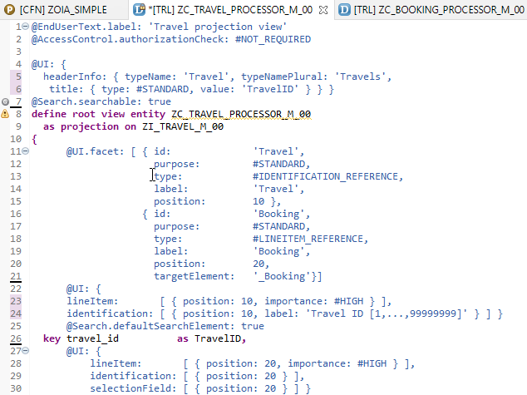
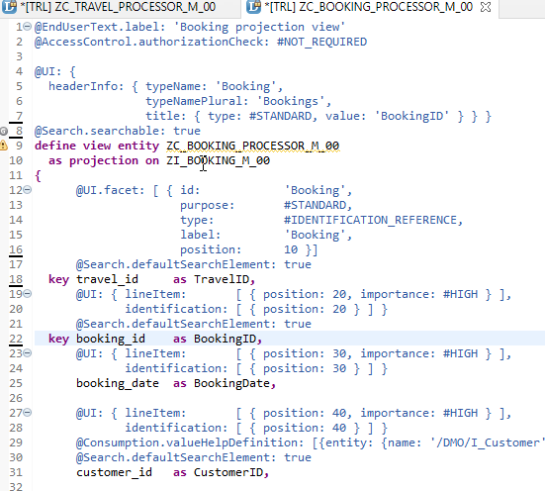
Projection CDS View’s for Processor
Projection CDS View for Travel Info “ZC_TRAVEL_PROCESSOR_M_00”
Projection CDS View for Booking Info “ZC_BOOKING_PROCESSOR_M_00”

Slide 5
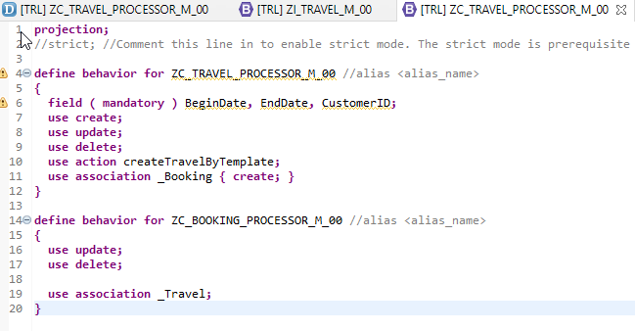
Behaviour Definition for Processor
“ZC_TRAVEL_PROCESSOR_M_00”
Behavior Definition for Projection CDS’s Views of Processor.

Slide 6
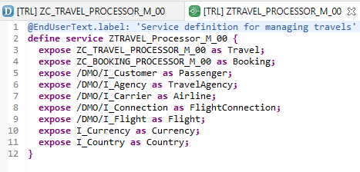
Service Definition
“ZTRAVEL_PROCESSOR_M_00”
Service Definition for Expose Entity

Slide 7
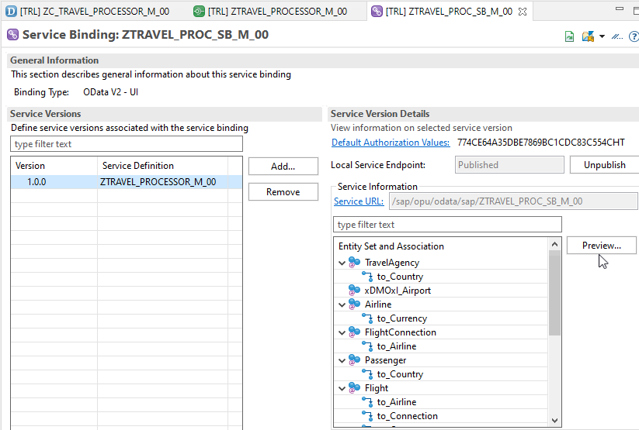
Service Binding (OData)
After Creating Service Binding , Select Entity and Click on Preview

Slide 8
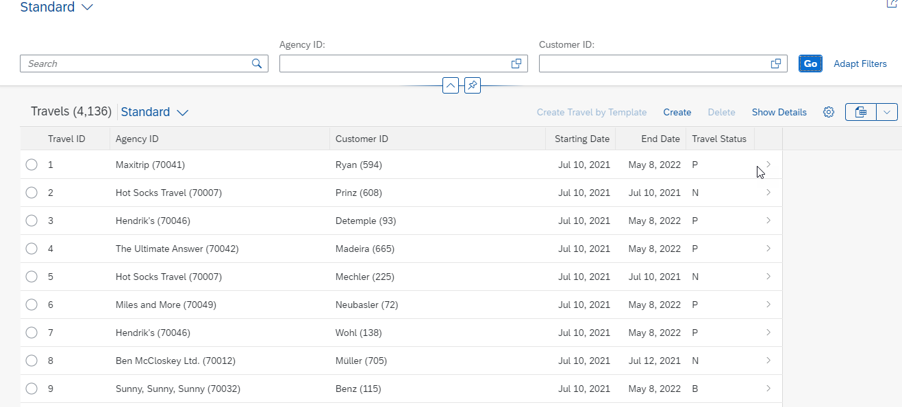
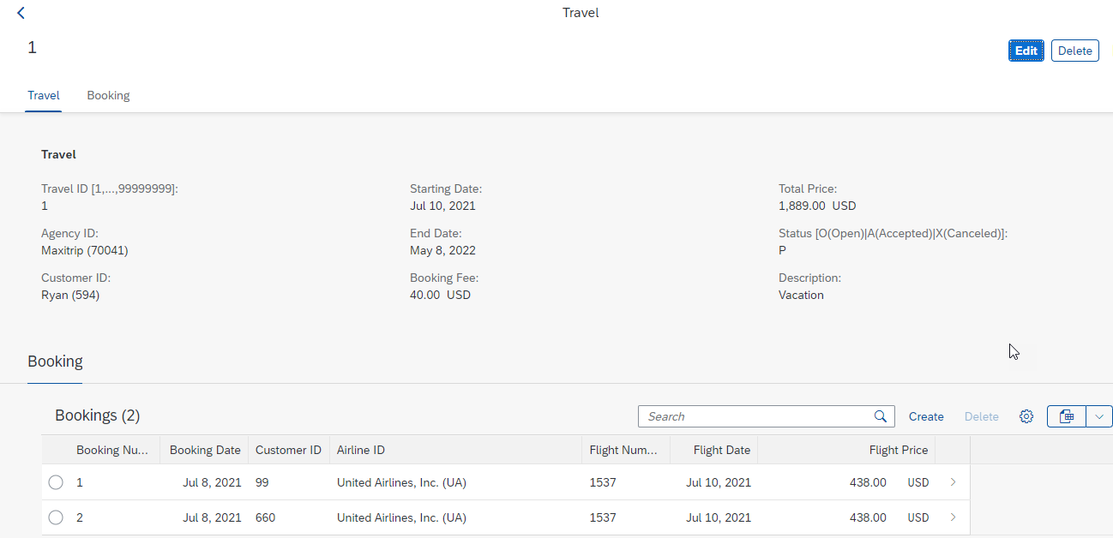
Final Result of Processor App
1st Screen with Search Bar & Filter Bar
2nd Screen with Travel and Booking Data,
& C-R-U-D Functionality

Slide 9
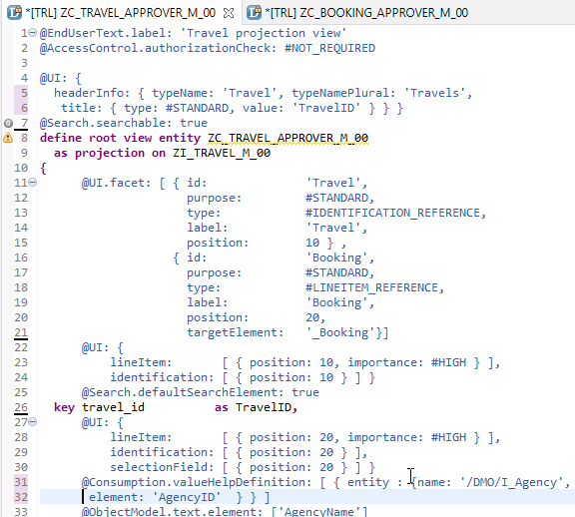
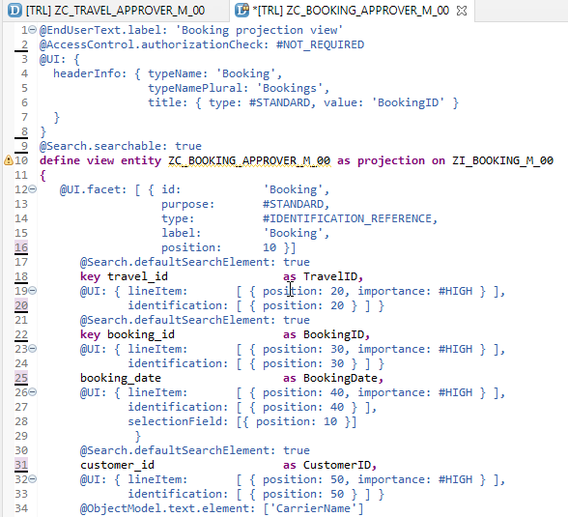
Create CDS View’s for Approver
Projection CDS View for Travel Info “ZC_TRAVEL_APPROVER_M_00”
Projection CDS View for Booking Info “ZC_BOOKING_APPROVER_M_00”

Slide 10
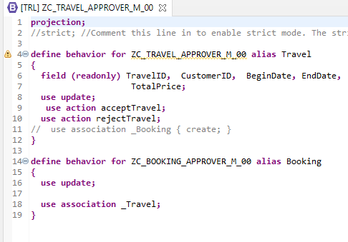
Implementing Behaviour Definition
“ZC_TRAVEL_APPROVER_M_00”
Behavior Definition for Projection CDS’s Views of Processor.

Slide 11
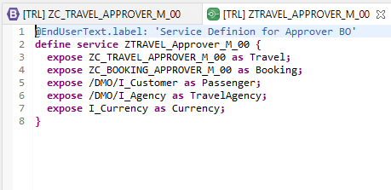
Service Definition
“ZTRAVEL_APPROVER_M_00”
Service Definition for Expose Entity

Slide 12
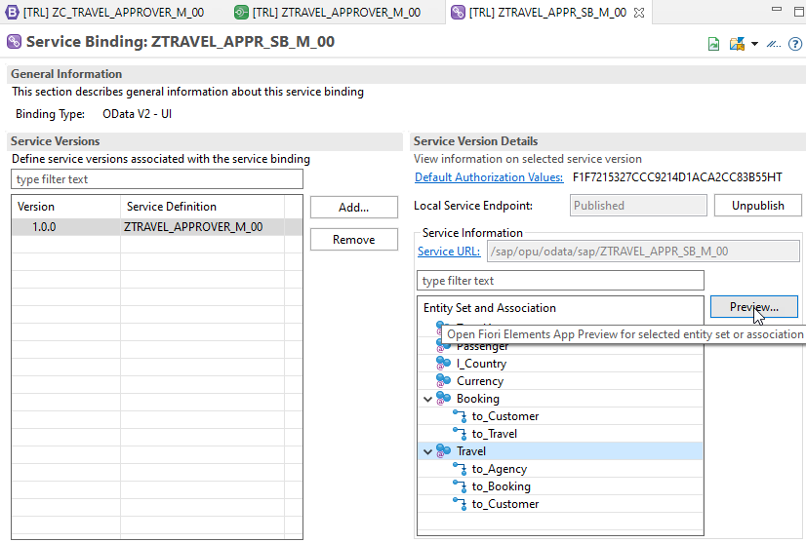
Service Binding
After Creating Service Binding , Select Entity and Click on Preview

Slide 13
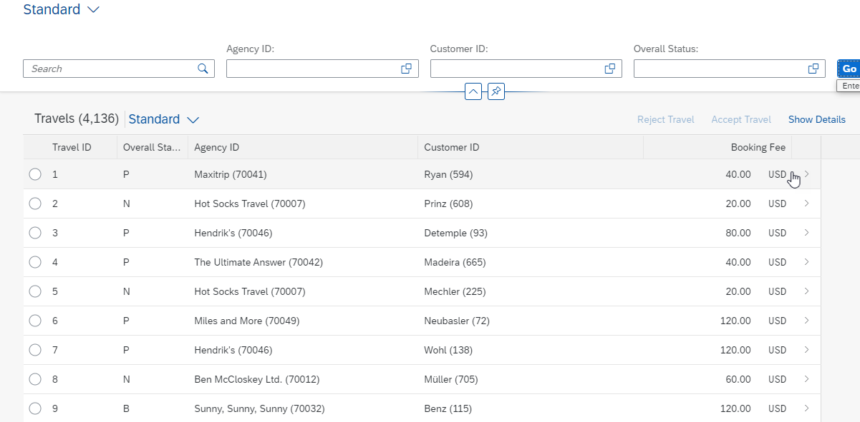
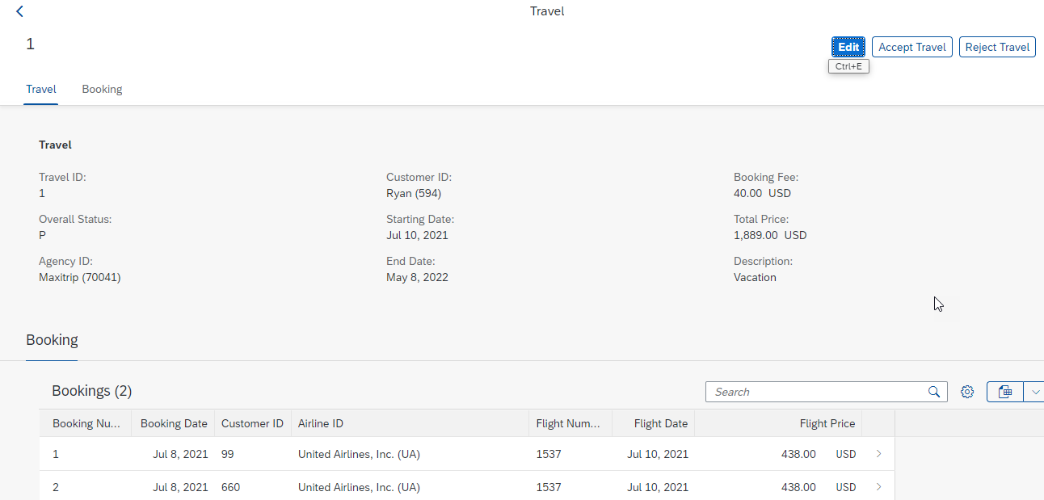
Final Result for Approver App
1st Screen with Search Bar & Filter Bar
2nd Screen with Travel and Booking Data,
& Approve or Reject Functionality

Slide 14

End of Day 30
Trainer: Anubhav Oberoy

Slide 15

Trainer: Anubhav Oberoy

Slide 16
THANK YOU
If you cannot do
great things, do small things in a great way.
Anubhav Oberoy
https://www.anubhavtrainings.com

Slide 17


We’re committed to empower you to be
Most Desirable Resource
through powerful training solutions.
We build the workforce of the future.
250+
Corporate Clients
30,000+
Learners Trained
25000+
Learners Placed
FREE WEBINARS
Sign up for free webinars with industry experts every fortnight!
Enroll Now!
Contact us today!
https://anubhavtrainings.com/

Slide 18




More from AnubhavTrainings.com

